Slide 1
Techlogies and advantages

Slide 2
About us
ASVA TRADING is the exclusive supplier of the ASVA® spare parts in Europe
Key area of activity is WHOLESALE of spare parts for passenger cars
Spare parts for consumers, who are not ready to overpay for a brand name but want to purchase auto parts of worthy quality
We offer our customers reasonable prices for certified
and tested alternative spare parts
for vehicles made in Japan, Korea,
Europe, USA
WWW.ASVA-TRADING.COM

Slide 3
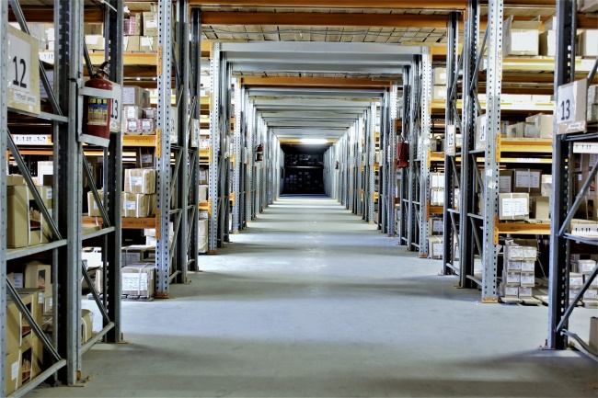
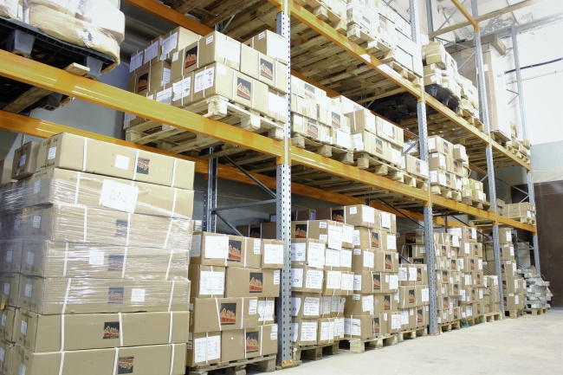
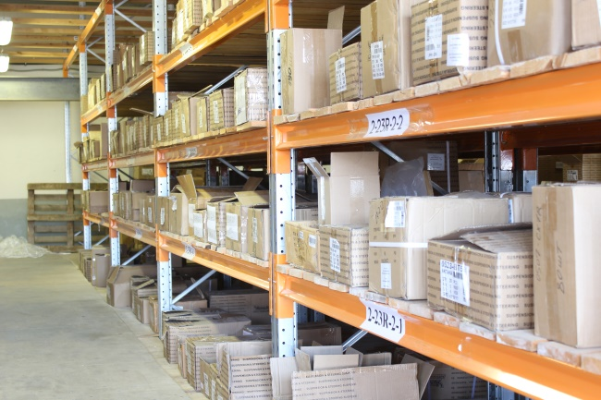
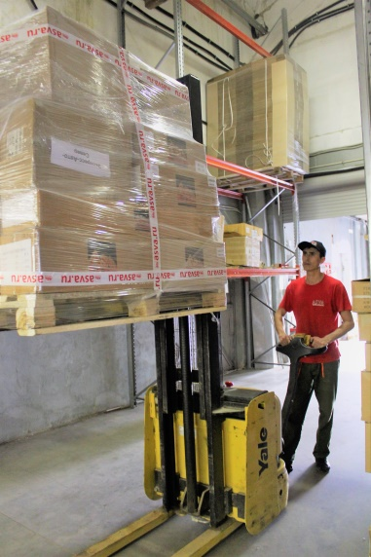
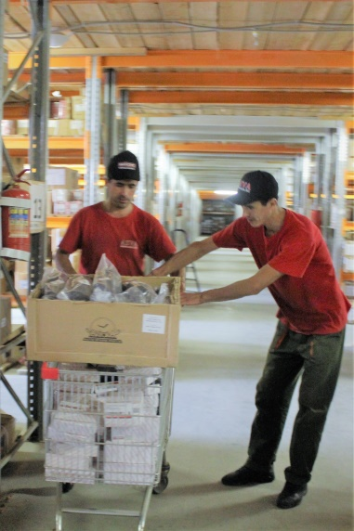
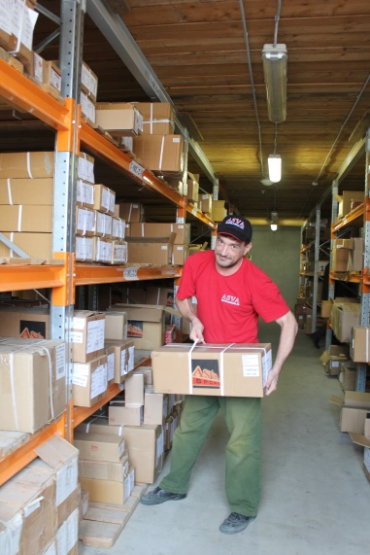
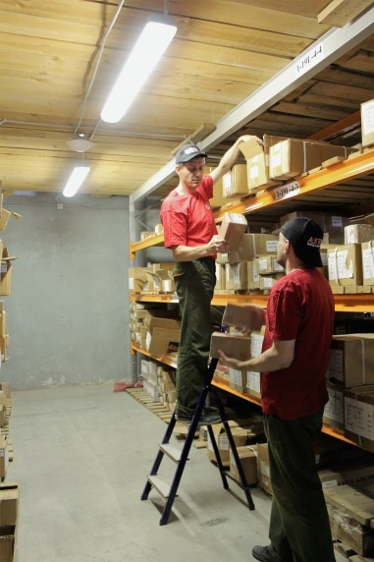
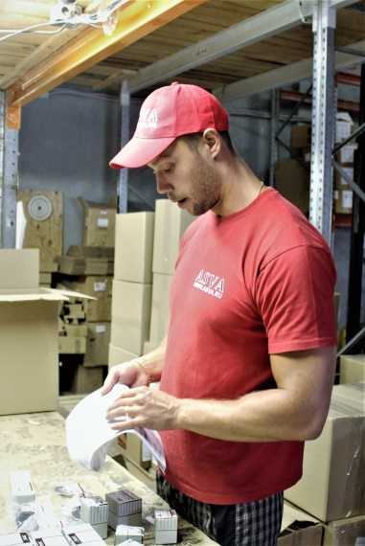
The company was established in 2003.
Warehouse size : 2200 m³
Number of persons employed : 98
WWW.ASVA-TRADING.COM

Slide 4
Company brief history
2019
New range launching– brake calipers ASVA
2018
Entry into new markets - Kazakhstan, Belarus
2018
Start of replace brand Akitaka with ASVA
2017
Line extension of all ranges at or north of 20 percent
2016
Opening of a branch offices in Krasnoyarsk (Russia)
2015
New range launching– strut mountings, engine mountings, tension rollers ASVA
2014
Achieving “TecAlliance CERTIFIED DATA SUPPLIER" commendation
2013
Opening of a branch offices in Krasnodar, Irkutsk, Vladivostok (Russia)
2012
Opening of a branch offices in Rostov-on-Don , Ekaterinburg (Russia)
2012
New range launching– wheel hubs ASVA
2012
New warehouse in Moscow 2400 sq m
2011
New range launching– bushings AKITAKA
2010
Opening of a branch offices in Novosibirsk, Khabarovsk (Russia)
2007
Registration of brand AKYOTO
2006
Registration of brand AKITAKA
2003
Establishment of a company and registration of brand ASVA

Slide 5
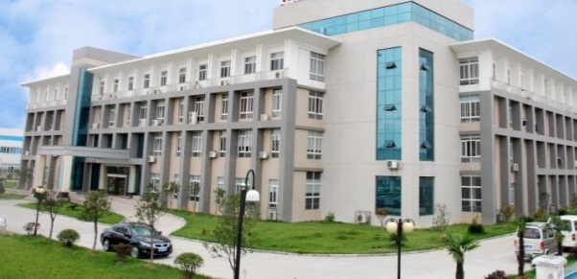
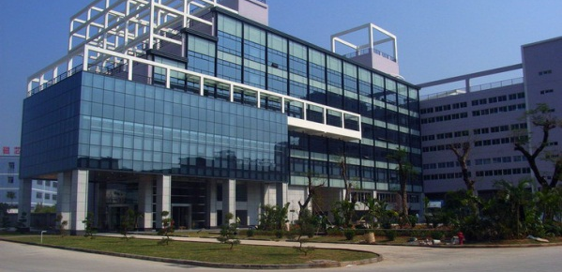
Plants
Over 40 plants in Southeast Asia
WWW.ASVA-TRADING.COM

Slide 6
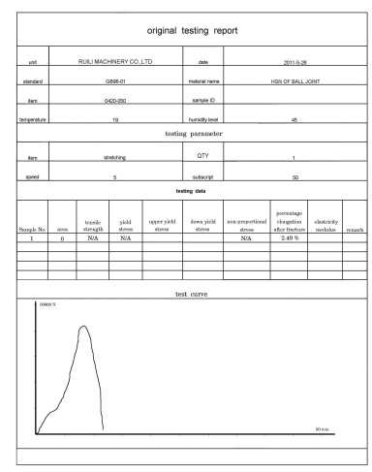
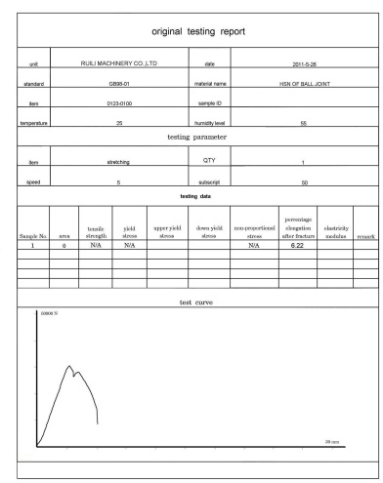
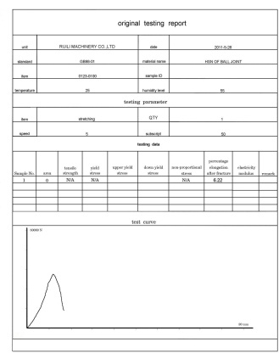
Quality control
Our products are high-graded, because we:
choose the best materials
test our products using peculiar test equipment
make products with allowance for severe driving conditions
use self-design projects
The finished products undergo a series of special tests. Each test cycle takes several days and simulates a mileage of several thousand kilometers. Finished items are tested to failure to diagnose critical loads and undergo long-term tests to simulate road conditions in aggressive environments.
WWW.ASVA-TRADING.COM

Slide 7
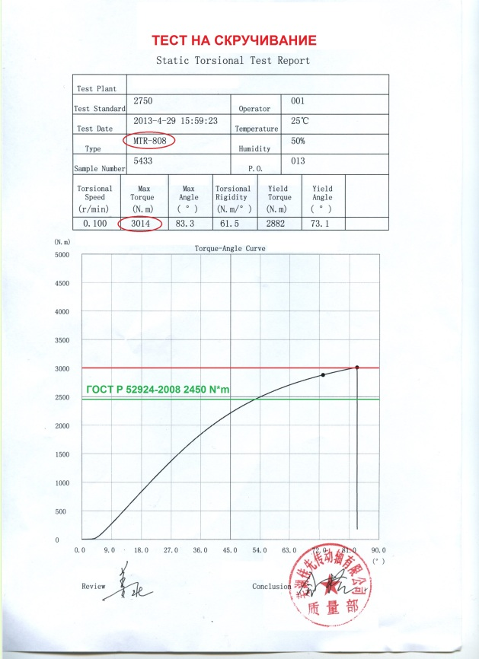
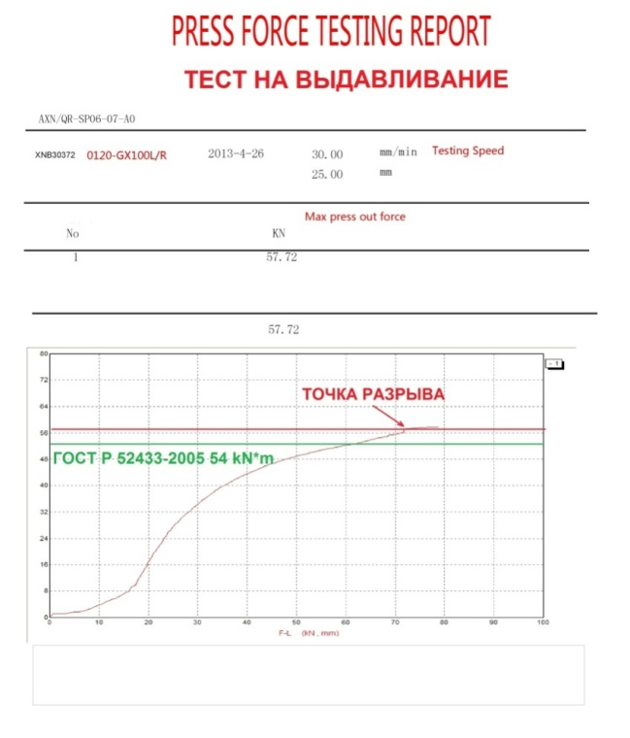
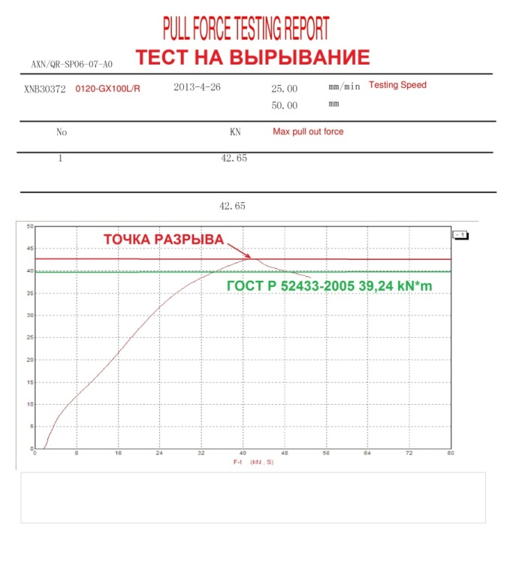
Product testing
Test results must be documented. When accepting goods for quality in production, our employees study the results of the tests carried out and, if in doubt, conduct additional testing under the control of an expanded commission. Confirmed test results are archived and by them we can track the quality of virtually every detail in the event of non-standard cases.
www.asva.ru
WWW.ASVA-TRADING.COM
www.asva.ru
+7(495) 902-64-58

Slide 8
ASVA® Products
CV Joints
Hubs and wheel bearings
Drive Shafts
CV Joint Boots
Drive Shafts Assembly
Tension rollers
Brake calipers
Bushings
Ball joints
Strut mountings
Engine mountings
Tie-rod ends
Control arms
Stabilizer rods
Tie rods
The manufacturing is carried out on modern certified equipment by permanent control of the compliance with manufacturing processes. Technical characteristics and parameters of the ASVA® products exactly match those of original products by world-known manufacturers.
An example of such a policy would be the use of AAR type tripoids, which improves the performance of a part significantly. Usually, manufacturers of non-genuine spare parts do not use this type of tripoid.
ASVA TRADING LTD
WWW.ASVA-TRADING.COM

Slide 9
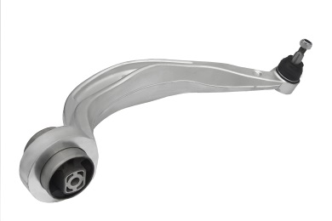
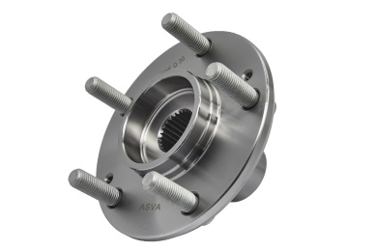
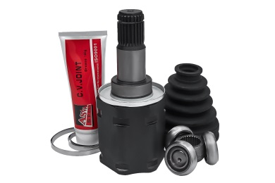
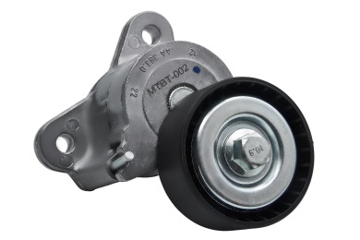
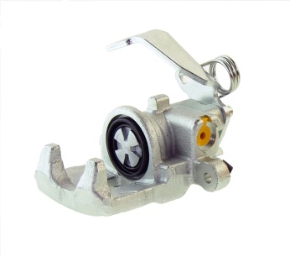
ASVA® Products
Items | >7 100
CV Joint boots | >300
Wheel hubs | >450
CV Joints outer | >750
CV Joints inner | >600
Drive shafts assembly | >80
Wheel bearings | >150
Tension rollers | >250
Brake calipers | >300
Stabilizer bushes | >350
Bushings | >1250
Control arms | >550
Stabilizer rods | >400
Tie-rod ends | >200
Tie-rod axle joints | >200
Ball joints | >200
Engine mountings | >500
Strut mountings | >200
Engine mount cushions | >550
WWW.ASVA-TRADING.COM
ASVA TRADING LTD

Slide 10
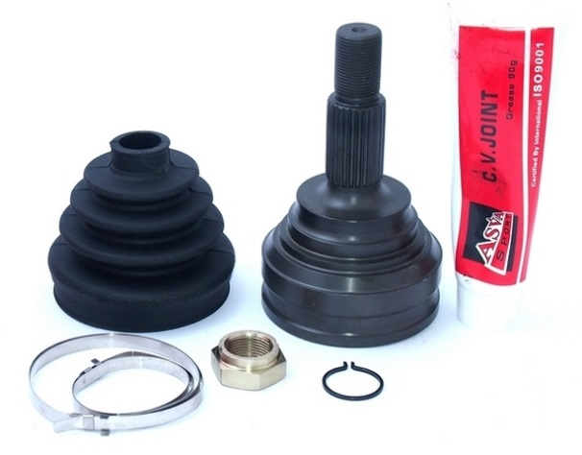
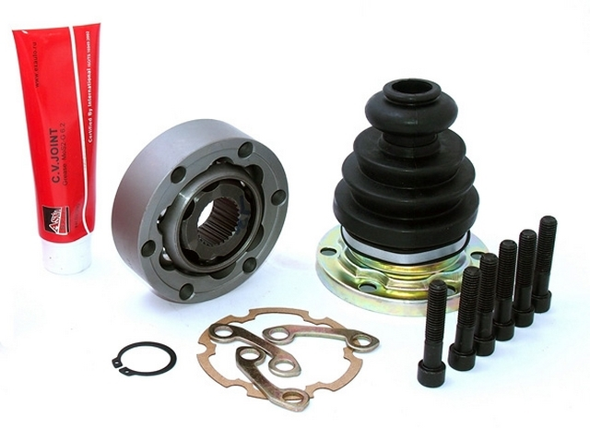
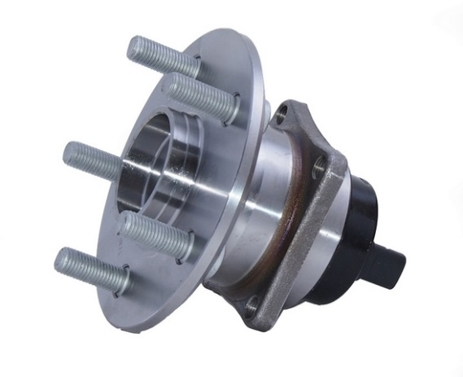
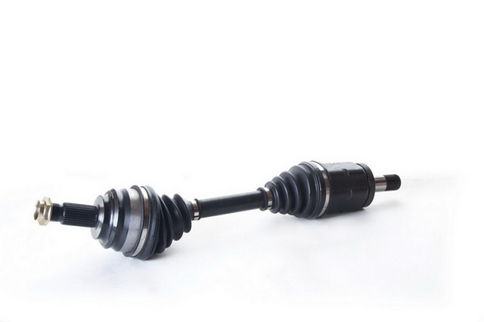
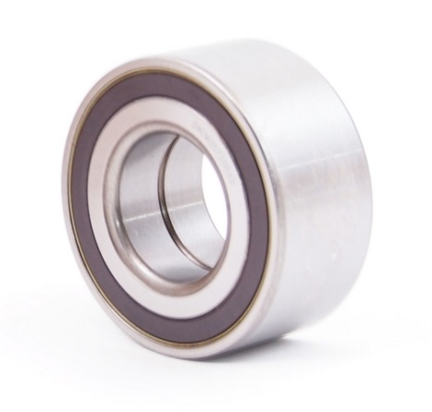
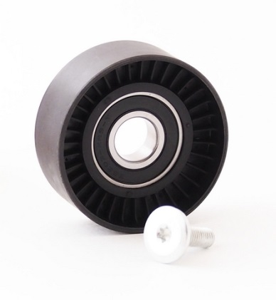
ASVA® Products
WWW.ASVA-TRADING.COM

Slide 11
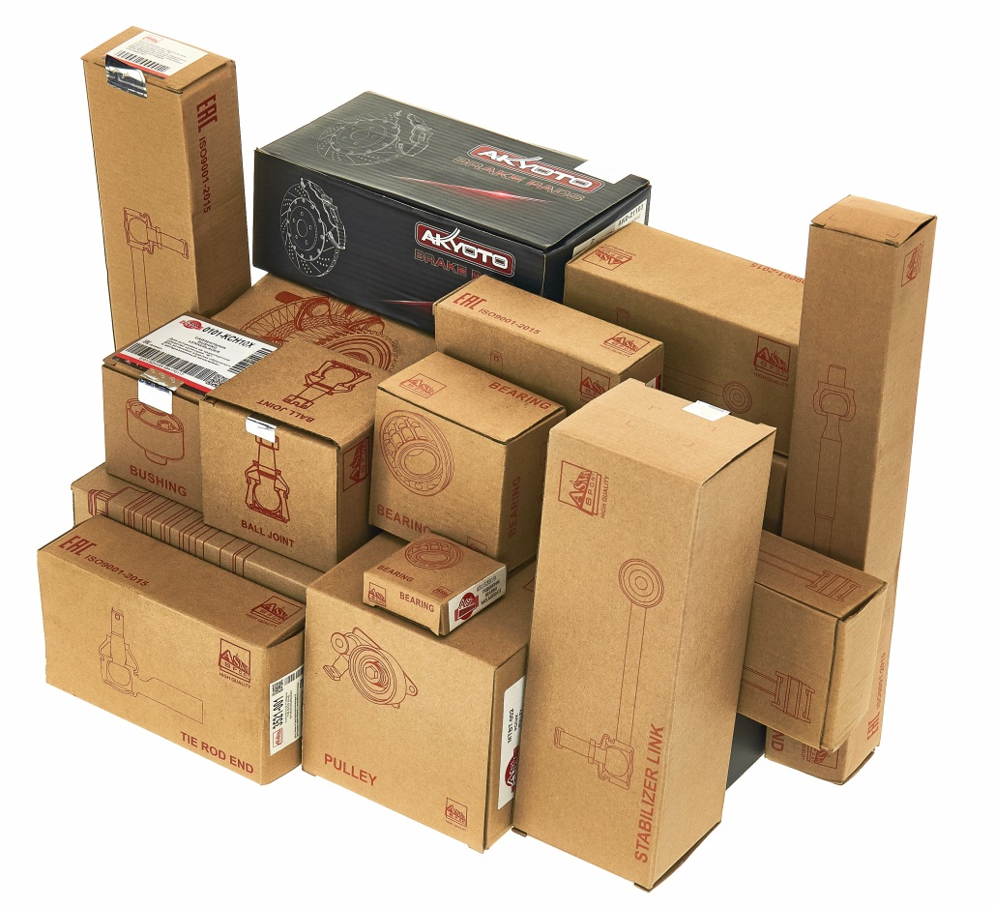
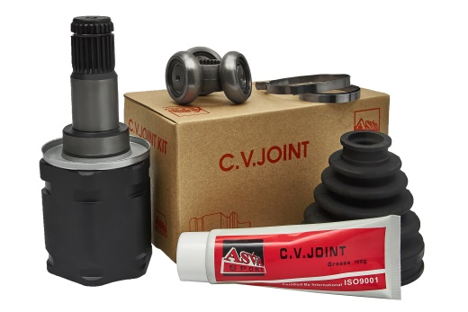
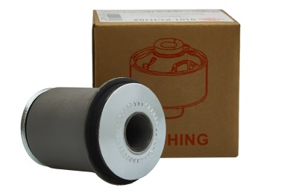
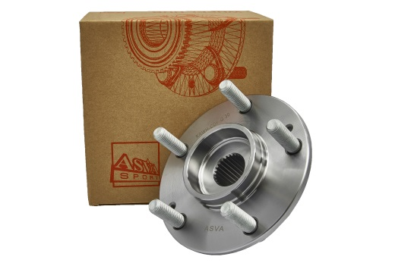
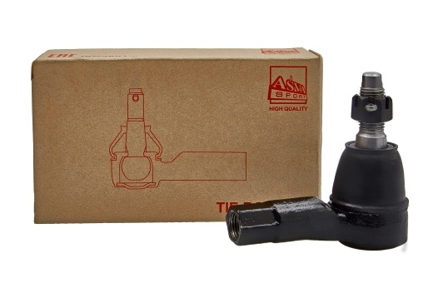
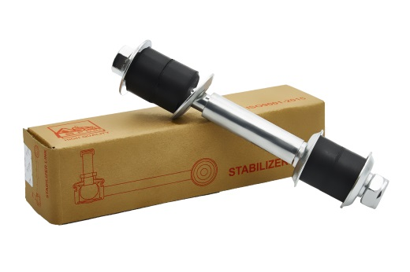
Functional and recognizable package
WWW.ASVA-TRADING.COM

Slide 12
TecDoc
Sinse 2014 ASVA COMPANY has had achieved the "TecAlliance CERTIFIED DATA SUPPLIER" commendation
Brand ASVA® is officially rated status A-Supplier by TecAlliance

Slide 13
Warranty
24 months
It is important to feel the dependability of a partner and we understand this well. It is possible to exchange or return ASVA products within the framework of European Law. According to statistics for 2019, only 0.2% of parts were returned due to manufacturing complaints

Slide 14
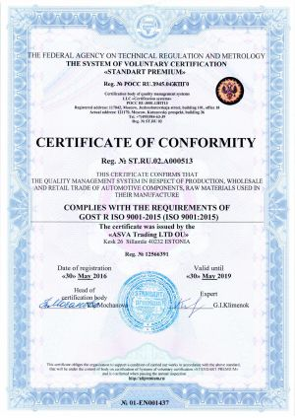
Quality Certificates
Quality of products is confirmed by:
certificate EACU (Eurasian Customs Union)
certificate ISO 9001:2015

Slide 15
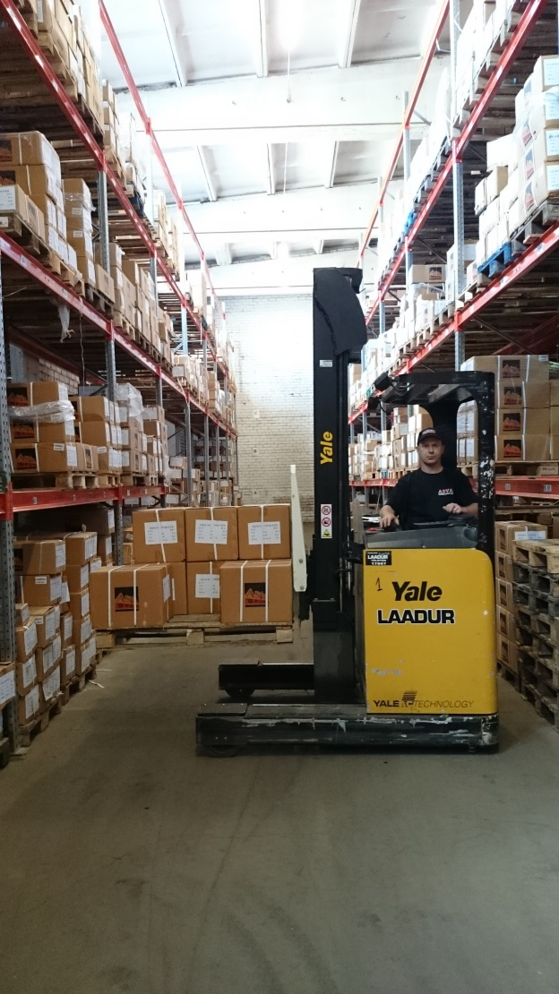
Legal notice
ASVA TRADING LTD OÜ
Tallinna mnt 3, Sillamäe linn,
Ida-Viru maakond, 40233
Eesti Vabariik / Estonia
Reg. 12566391
KMKR EE101707930
Warehouse: Tallinna maantee 3, Sillamäe linn, Ida-Viru maakond, 40231
Eesti Vabariik / Estonia

Slide 16
E-mail: europa@asva-trading.com
manager@asva-trading.com
Теl. +372 56936772
www.asva-trading.com
ASVA TRADING LTD

